Slide 1
OOPS PROJECT ATTENDANCE MANAGEMENT SYSTEM
Under the Supervision of: By:
Prof. Rohit Beniwal Madhvan Sharma (2K19/SE/068)
Department of CSE Himesh Mahabi (2K19/SE/054)

Slide 2
INTRODUCTION
Attendance management system is a program developed for daily student attendance in colleges , educational institutions, etc. like DTU.
It gives students access to view their attendance in a specific class as percentage or number.
The Information of Students (like Username, Password, etc.)will be managed by Admins which can be assigned by the teachers of a Particular class.
This system also helps in evaluating the eligibility criteria of students for giving Examinations (which is above 75% in DTU).
The main objective of developing this Project was to digitize the traditional way of taking attendance.
Another purpose was to generate the attendance report whenever required.

Slide 3
ABSTRACT
Our project, “Attendance Management System” is a program which deals with the maintenance of student’s attendance details.
It allows teachers to mark their student’s attendance. It is maintaining a daily basis of attendance .
Admin will be provided with the separate Username and Password to maintain student’s attendance.
The Teacher(s) handling the particular subject(s) are responsible for taking attendance of each student present in that class
Students are marked present only if they are present on that particular date.
The percentage (%) attendance of students will be calculated daily.

Slide 4
OBJECTIVE
To increase efficiency of marking and viewing attendance.
To provide fast access of data.
To provide a secure and smooth program for marking attendance.
To indicate the student’s attendance on a daily as well as monthly basis.
To help in evaluating the eligibility criteria of student(s) in the examination w.r.t minimum attendance percentage (%) which is 75% in DTU.

Slide 5
OOPS CONCEPTS USED
Class
Object
Polymorphism
Inheritance
Header Files
File Handling

Slide 6
HIERARCHY CHART
USER CLASS
TEACHER CLASS
STUDENT CLASS
ADMIN CLASS

Slide 7
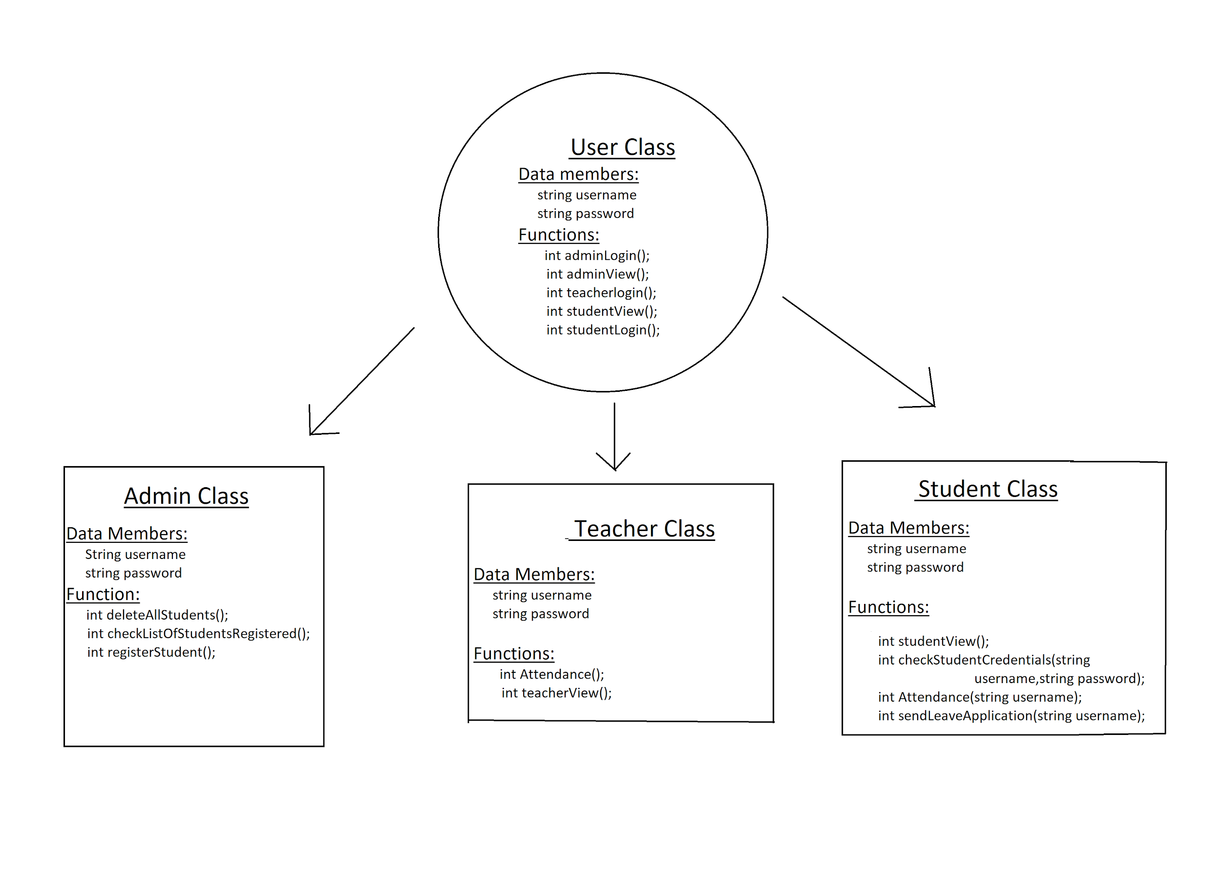
INHERITANCE IN DETAIL

Slide 8
FILE STRUCTURE
● User.h - It is the main header file containing the class user .
● Teacher
○ teacher_header.h :- header file containing teacher class.
○ teacher.cpp :- contains all functions of teacher class.
● Student
○ student_header.h :- header file containing student class.
○ student.cpp :- contains all functions of student class.
● Admin
○ admin_header.h :- header file containing admin class.
○ admin.cpp :- contains all functions of admin class.
● db.dat :- main database containing all registered students file name.
● application.dat :- contains all the leave application submitted by the students along with name and date.

Slide 9
EXPLANATION ABOUT THE PROJECT
The Program maintains two main files:
db.dat
Application.dat
Along with these file, a separate file named according to the username of the registered student is also maintained.
Db.dat is the database file i.e. it contains all the username (.dat) files addresses in it.
Application.dat is a file which contains the Leave application message and details that has been entered into the program by students.

Slide 10
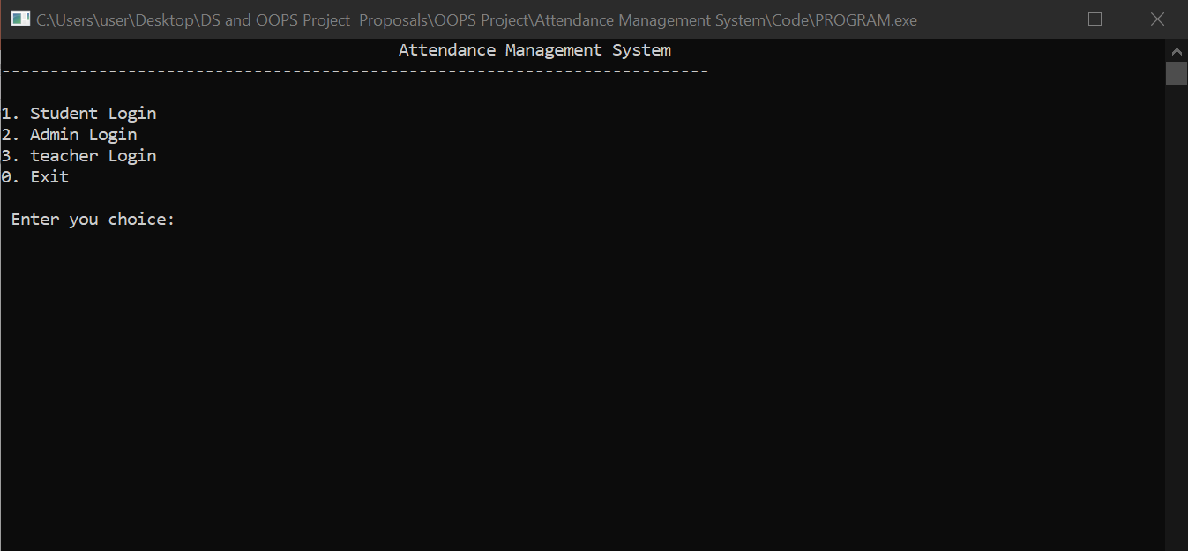
MAIN PAGE

Slide 11
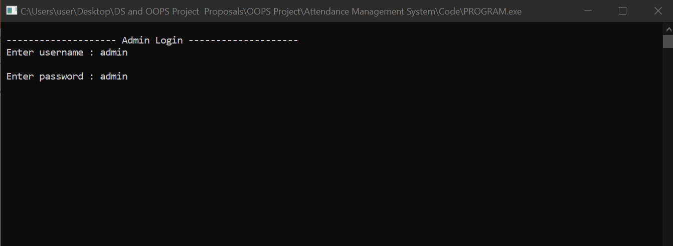
ADMIN LOGIN

Slide 12
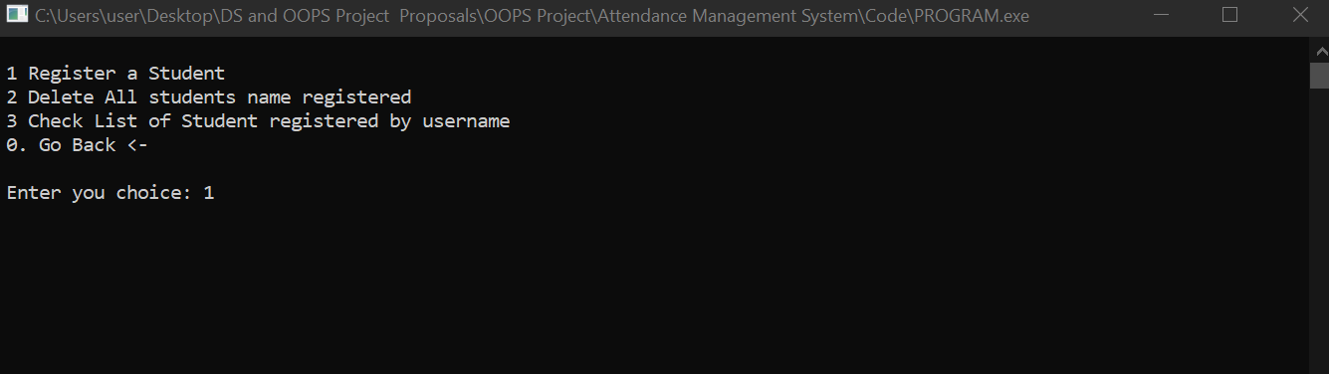
ADMIN MAIN PAGE

Slide 13
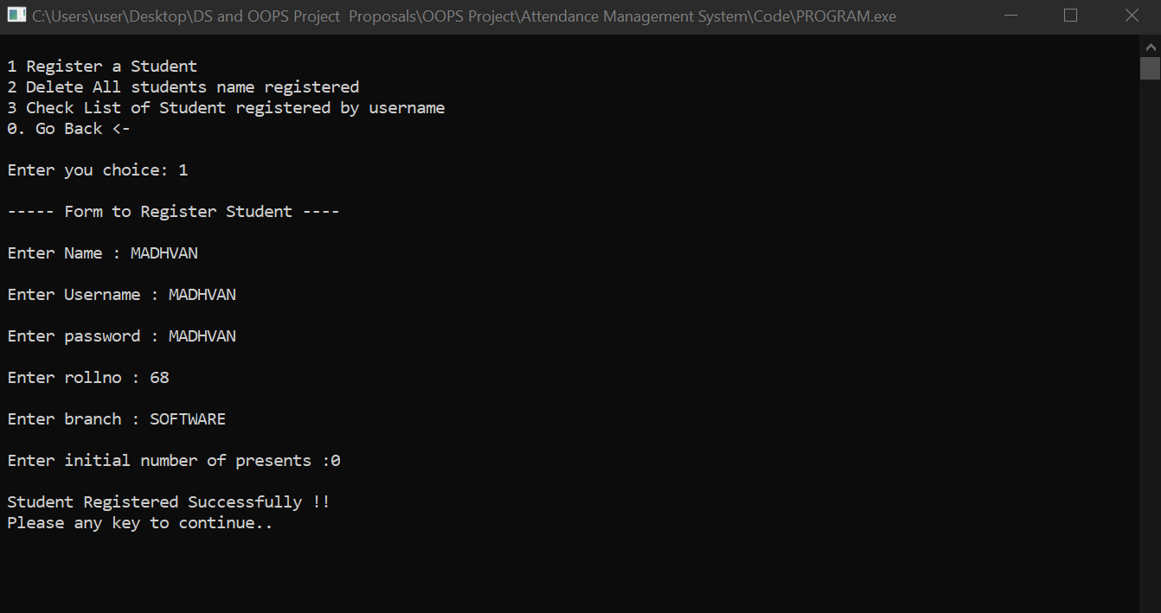
REGISTER STUDENT

Slide 14
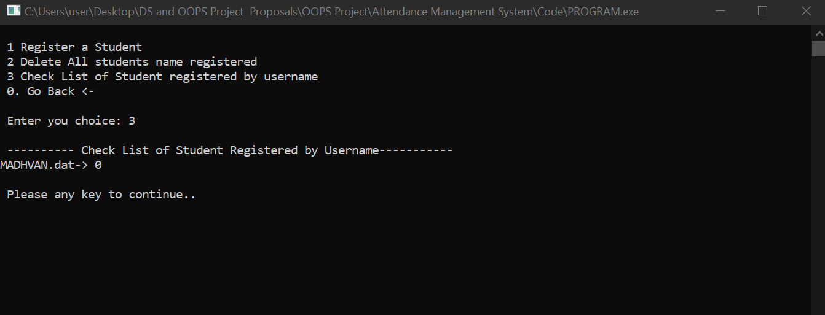
STUDENT LISTS

Slide 15
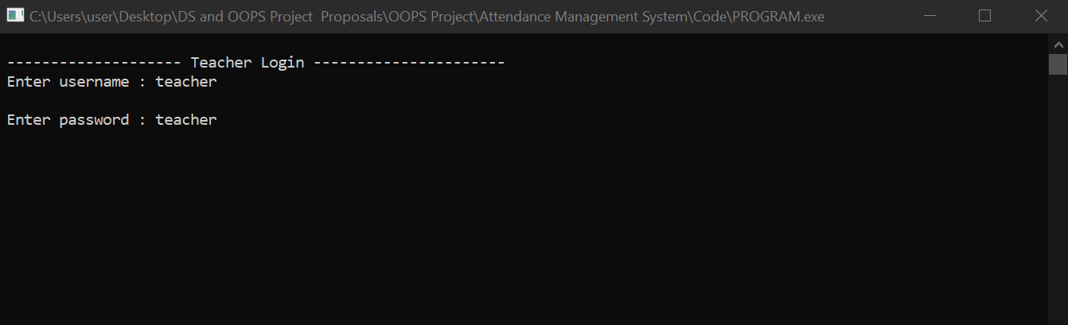
TEACHER LOGIN

Slide 16
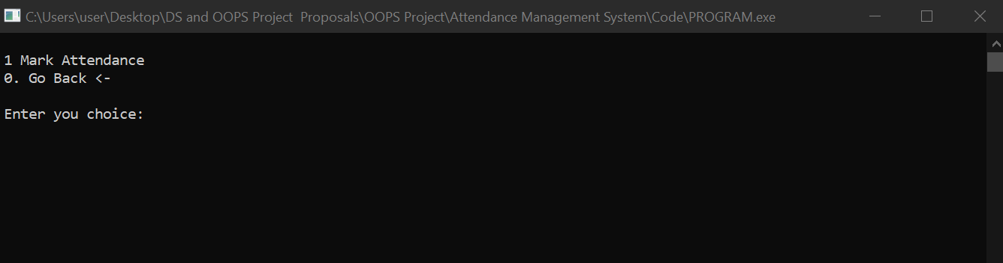
TEACHER MAIN PAGE

Slide 17
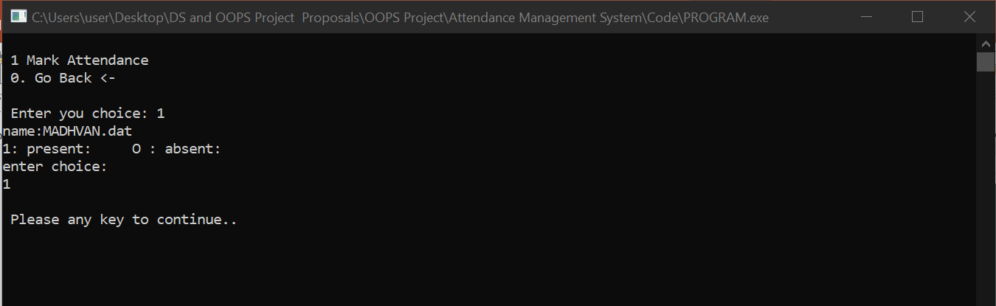
MARK ATTENDANCE

Slide 18
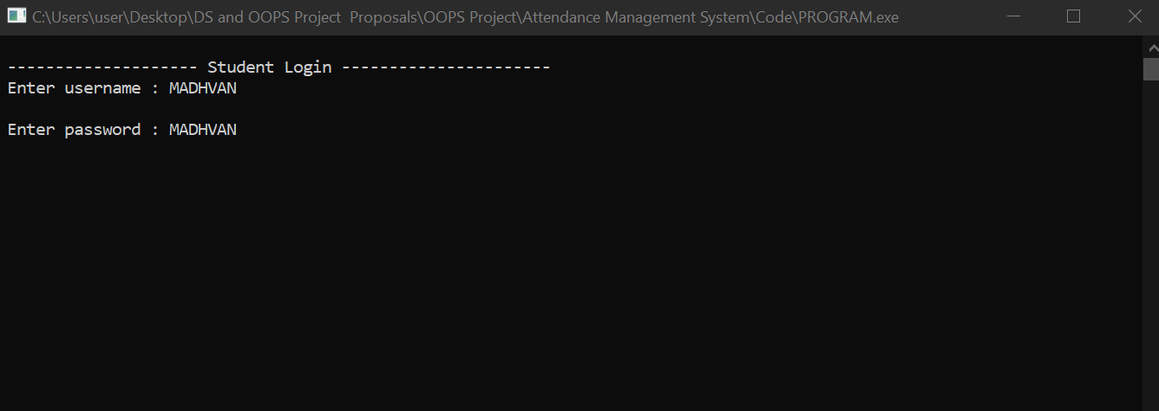
STUDENT LOGIN

Slide 19
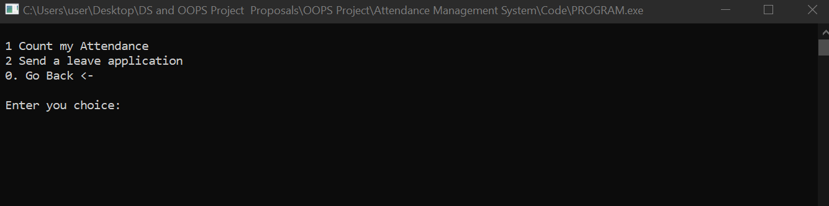
STUDENT MAIN PAGE

Slide 20
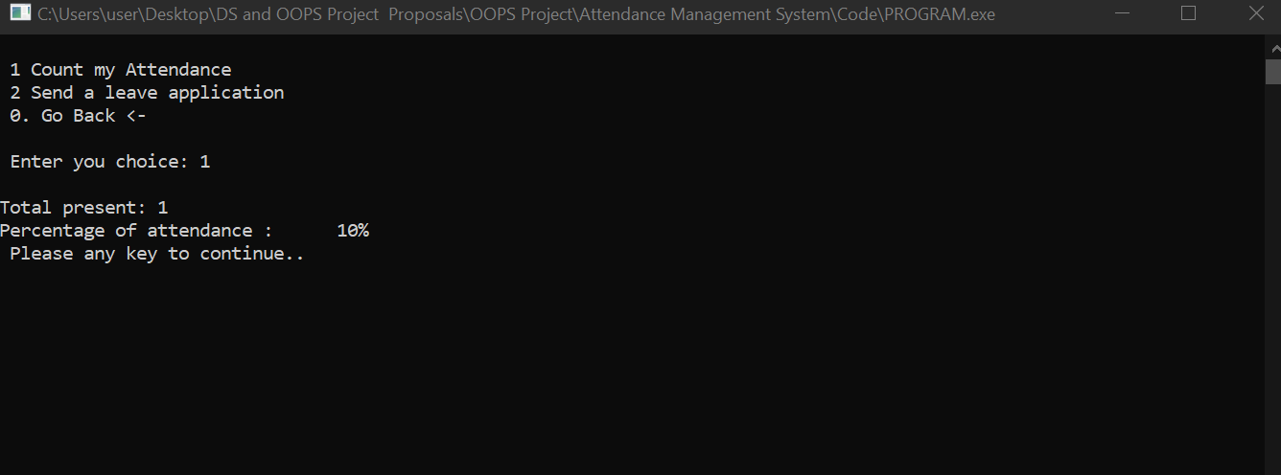
ATTENDANCE DETAILS

Slide 21
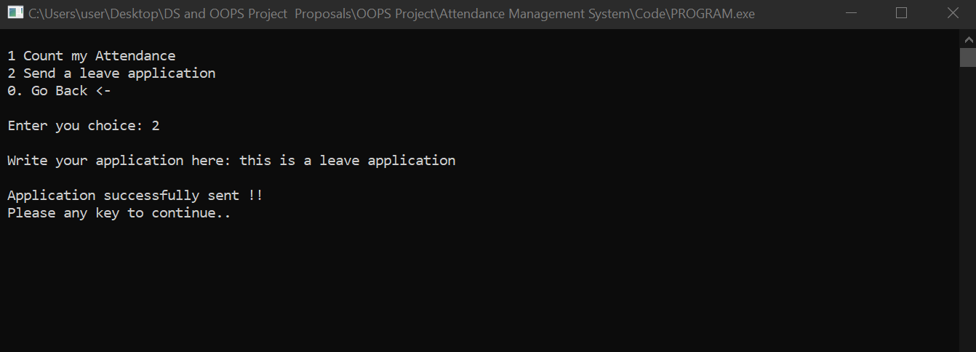
SENDING A LEAVE APPLICATION

Slide 22
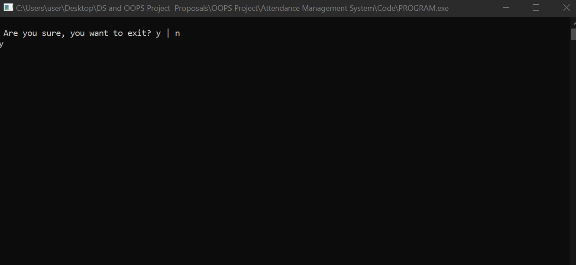
EXIT

Slide 23
CONCLUSION
This program reduces/eliminates the amount of manual data entry and provides more efficiency to the user
All the details about students, teachers and their other tasks can only be seen by the verified users (admins)
This program can be implemented in other academic institutes for getting better results regarding the conduction of attendance .
This program also saves time , reduces the amount of work the teachers and administration has to do.
Since Login Ids of Teacher and Admins are Password Protected , it is very safe and secure and also very convenient to use by administration, teachers and students.

